Slide 1
Machine Learning Methods for Population Genomic Inference
Dan Schrider

Slide 2
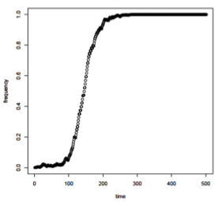
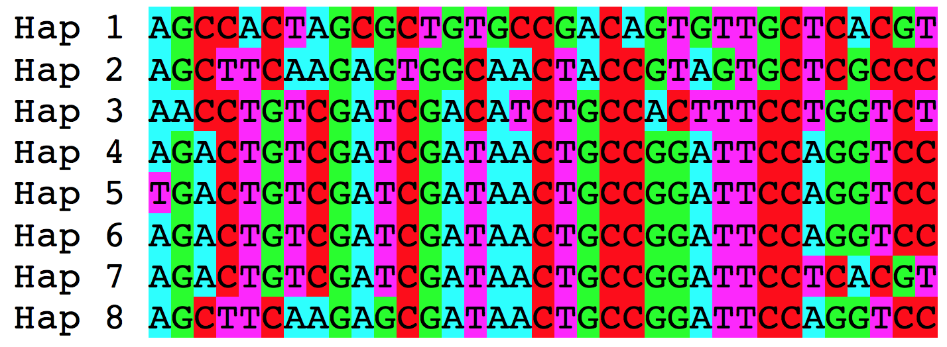
Population genetic inference
Evolutionary Phenomenon
Altered genealogy
Sequence alignment

Slide 3
Going in reverse
Infer presence of phenomenon of interest
Sweep or no?
Capture properties of genealogy with test/statistc
e.g. π, iHS
Sequence alignment

Slide 4
Summarizing patterns of diversity
There is a rich tradition (and literature) of developing problem-specific statistics for summarizing patterns of genetic variation from sequence data
Often the behavior of these statistics under theoretical models are well characterized (analytically and/or via simulation)
Let’s talk about one of them

Slide 5
π (nucleotide diversity)
π: Average pairwise diversity
If we grab two random chromosomes, how likely are they to be a heterozygote?
Can be measured at one site or averaged/summed across sites
Intimately connected to several key population genetic models/processes
But not very useful for inference, on its own…
where n=sample size
π_{i,j}=the fraction of sites that differ between sequences i and j.
Nei and Li (1979)

Slide 6

Capturing information in the alignment with summary statistics
or:
π
More statistics → more information about the genealogy → more power!
Machine learning is well suited for this.
Pavlidis et al. (2010), Lin et al. (2011), Ronen et al. (2013)
Pudlo et al. (2014), Pybus et al. (2015), Schrider and Kern (2016)

Slide 7
Outline
Detecting sweeps with machine learning
Demographic inference
Recombination rate estimation
Detecting introgression
Population genetic inference with machine learning without summary statistics

Slide 8
Part 1
Detecting sweeps with machine learning
Demographic inference
Recombination rate estimation
Detecting introgression
Population genetic inference with machine learning without summary statistics

Slide 9

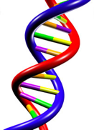
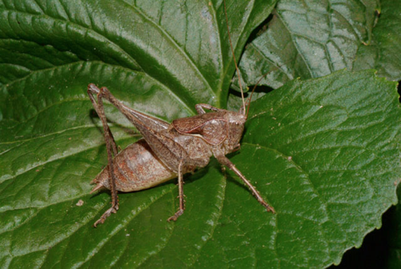
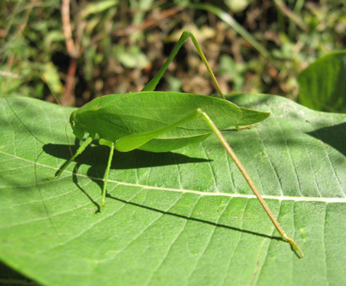
Positive selection
mutation + selection

Slide 10
Sweeps skew the site frequency spectrum (SFS)
Fraction of polymorphisms

Slide 11
SFSelect
Premise: instead of using a single stat, let’s use the SFS measured in a genomic window
-- Feature vector: the values in each bin of the SFS
Need a training set: simulate a bunch of sweeps and measure the SFS!
Train a support vector machine (SVM), and apply to the genome
Ronen et al. (2013)

Slide 12
SFSelect is not spatially aware
Regions closely linked to sweeps will be misclassified as sweeps: harder to narrow down the signature of selection.
Neutral
Sweep
Neutral
What we get:
Sweep site
Neutral
Linked to sweep
Sweep
Linked to sweep
Neutral
What we want:
Sweep site

Slide 13
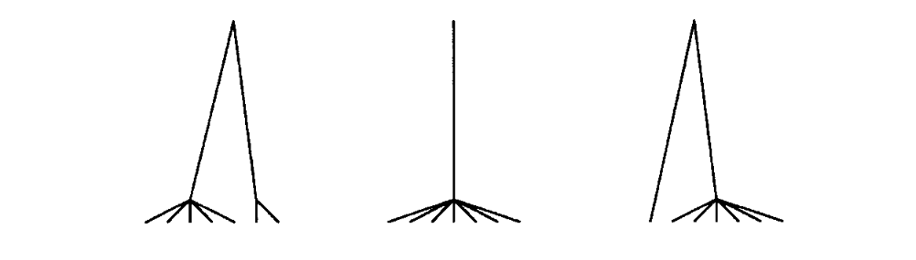
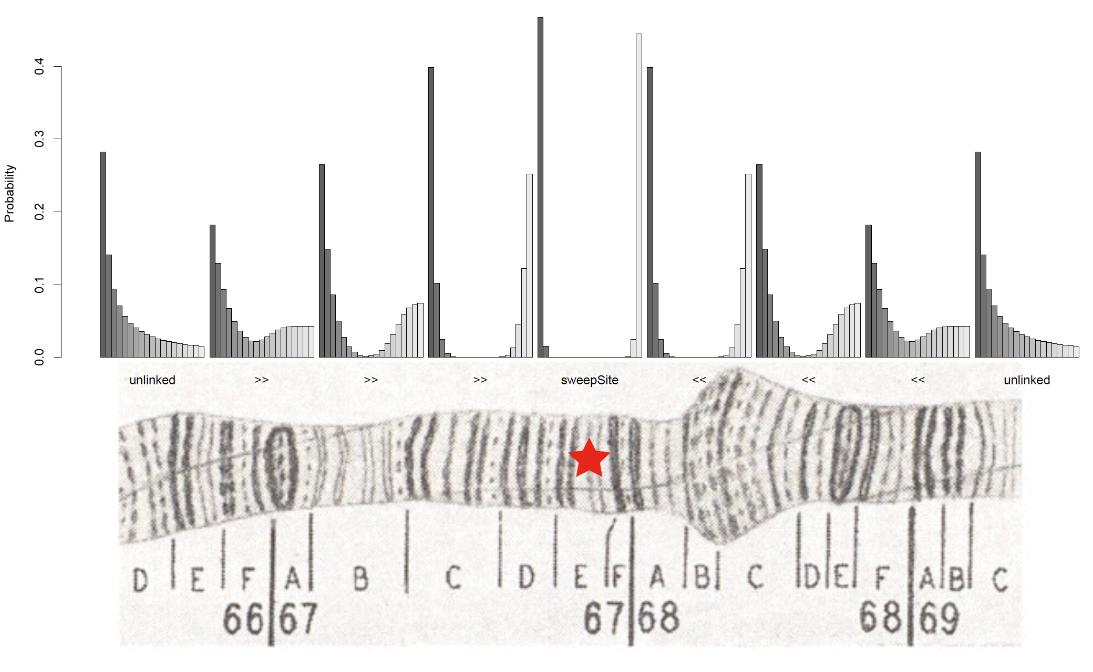

Slide 14
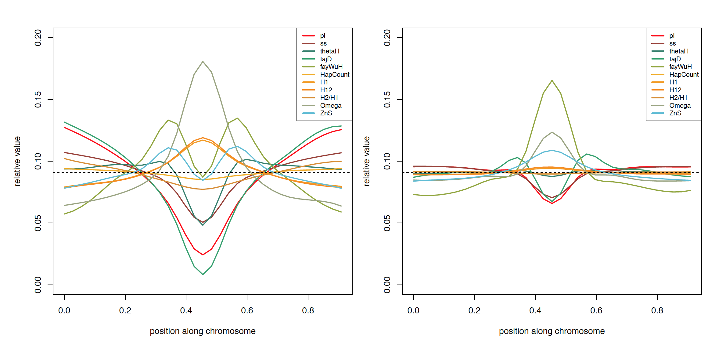
Multi-dimensional spatial patterns of variation around sweeps
Hard Sweep
Soft Sweep

Slide 15


Why machine learning?
Good for cases where mechanistic models are hard to come by
Supervised learning: good when lots of training data can be obtained
Good for high-dimensional data!

Slide 16
Spatially aware methods
evolBoosting: Tajima’s D, Fay and Wu’s H, and their components, and iHH
S/HIC: π, Tajima’s D, Fay and Wu’s H, the number of distinct haplotypes, average haplotype homozygosity, average r², Kim and Nielsen’s ω, etc
Trendsetter: π, avg r², # of distinct haplotypes, and the H₁₂ family of statistics (Garud et al. 2015)
Note: rather than calculating these in medium-sized subwindows: Trendsetter uses trend-filtered regression.

Slide 17
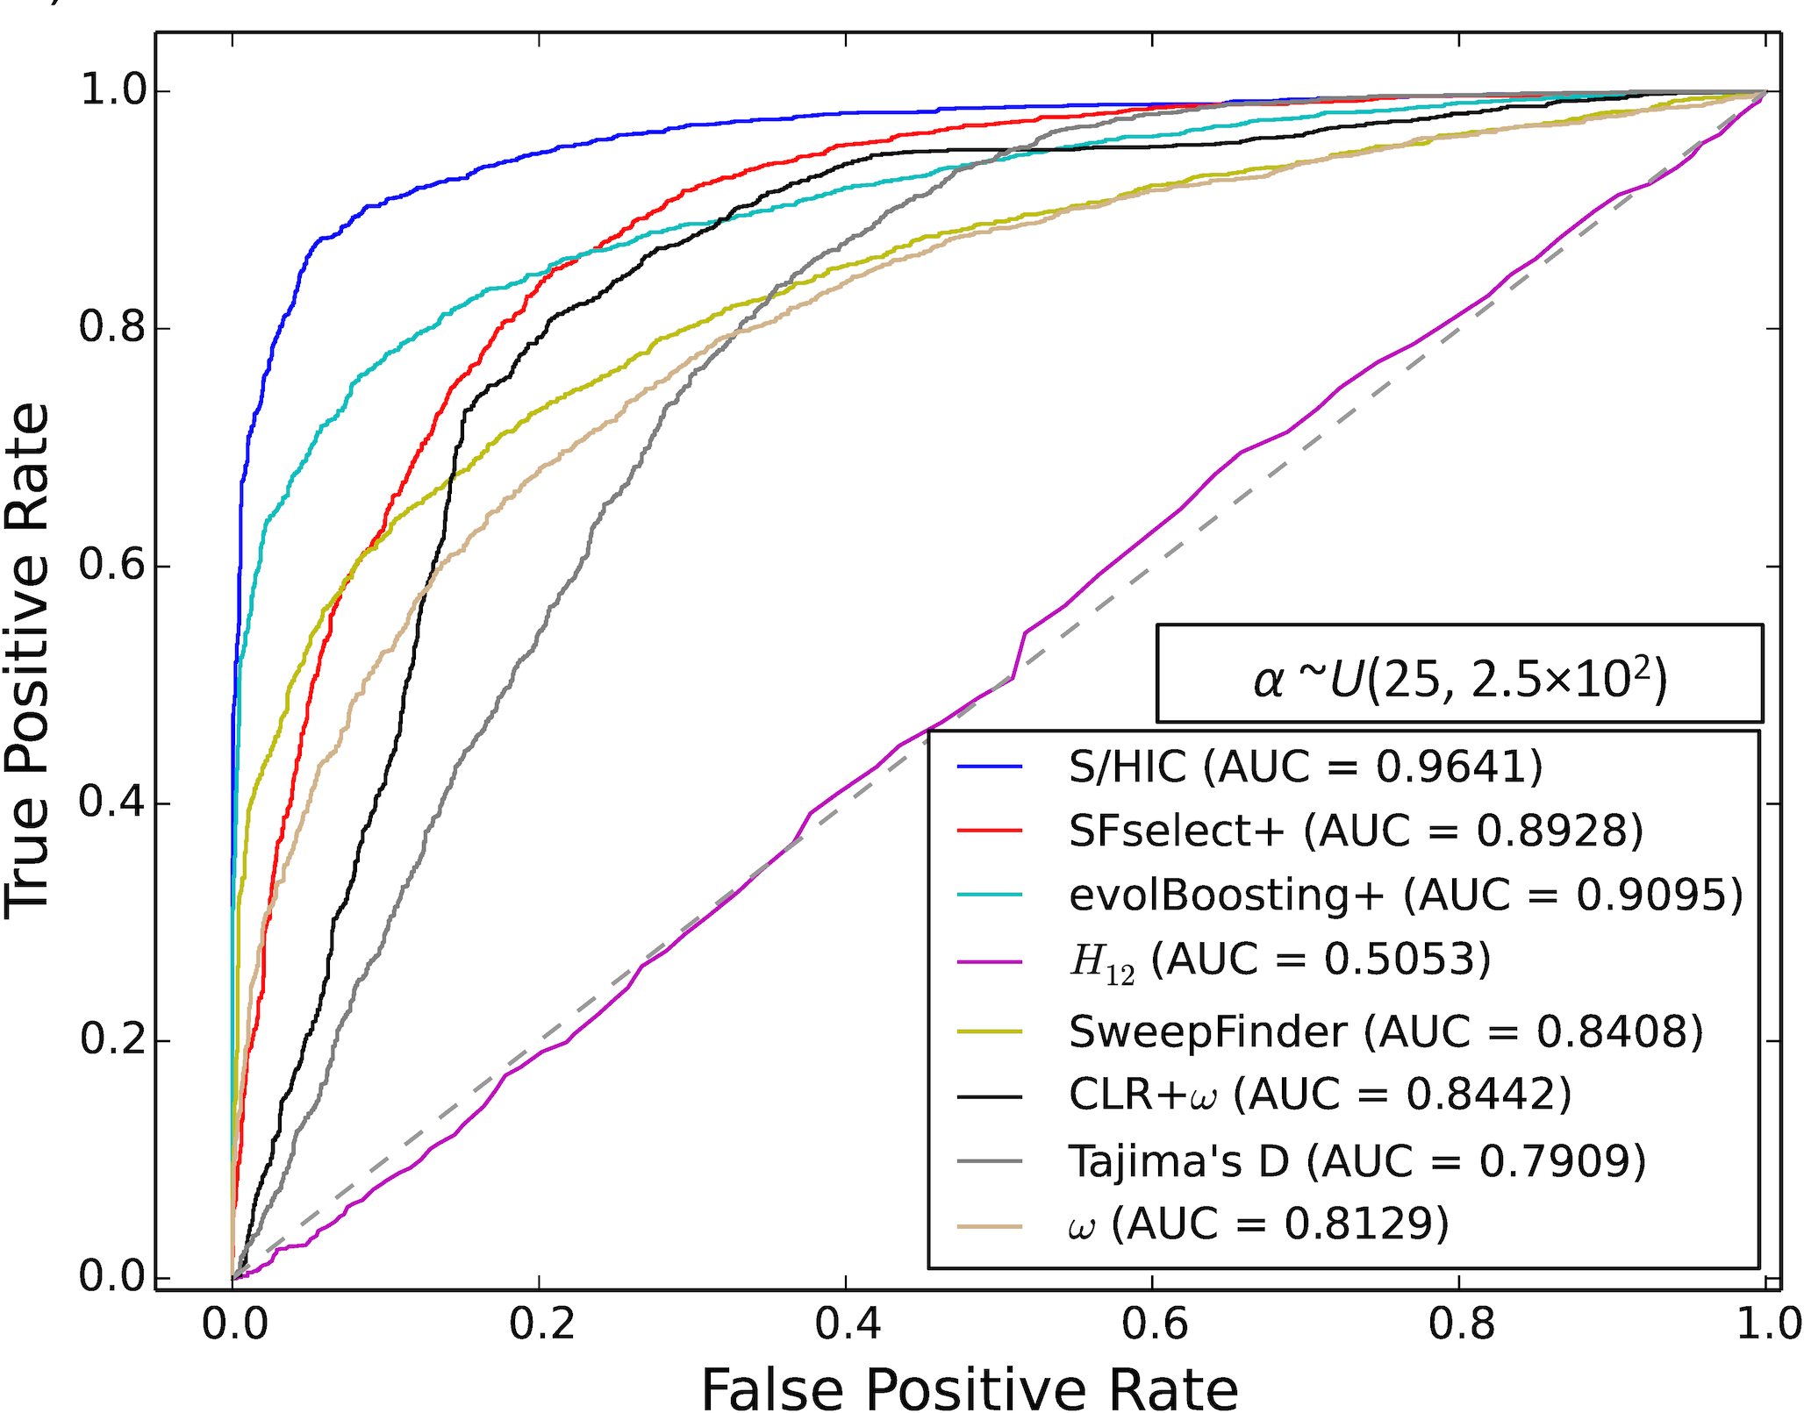
Power on simulated data
Note: the top methods on this data set are all machine learning approaches
(Trendsetter not shown, but does as well as S/HIC)

Slide 18
Strengths and weaknesses of spatially aware methods
Higher resolution and greater robustness to demography
Robustness to background selection (Schrider and Kern 2017; Mughal and DeGiorgio 2018)
Weaknesses: none.
(okay, a larger feature vector can be more computationally intensive to deal with but who cares?)

Slide 19
Traditional machine learning versus weird pop gen machine learning
Typical machine learning: train and test on real dataset before applying to some other real dataset
--perhaps some confidence that training/test data are distributed somewhat similarly to the application data set
Weird pop gen machine learning: train and test on simulated data before applying to real data
--perhaps you can hope that the training/test data are distributed somewhat similarly to the real data set, if you are careful enough in designing your simulations…

Slide 20
Summary (part 1 – sweeps)
Detecting sweeps is a difficult problem
By allowing us to capture more aspects of the input data, machine learning methods can help improve our power.
Some methods may suffer in the case of model misspecification: need to simulate lots of test data to find out!

Slide 21
Part 2
Detecting sweeps with machine learning
Demographic inference
Recombination rate estimation
Detecting introgression
Population genetic inference with machine learning without summary statistics

Slide 22
Why do we care about inferring demographic histories?
Because it’s interesting.
We need an appropriate null model for detecting selection.

Slide 23
Population size change vs. sweeps
Smaller N
Large N

Slide 24
Evidence of selection?
Compared to what?

Slide 25
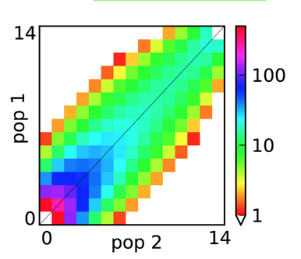
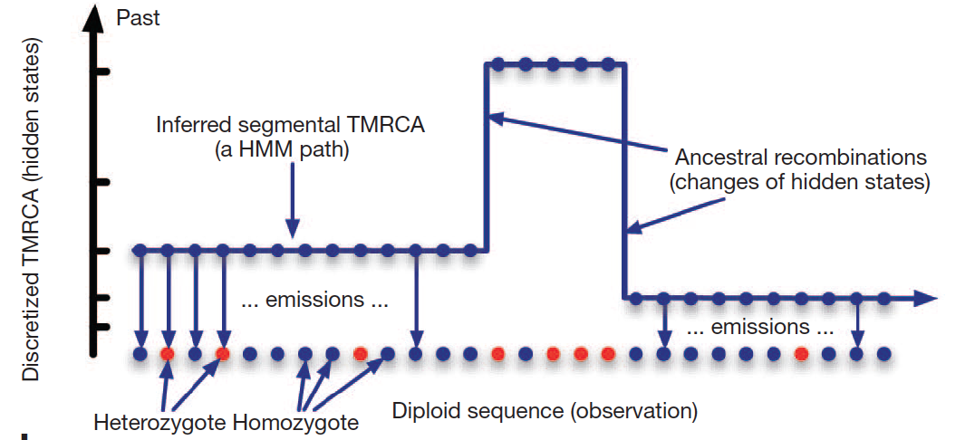
Multiple approaches for demographic inference
dadi: likelihood of joint SFS under a demographic model
PSMC/MSMC/SMC++: distribution of coalescence times of a sample
Let’s talk about a third way: Approximate Bayesian Computation (ABC)

Slide 26
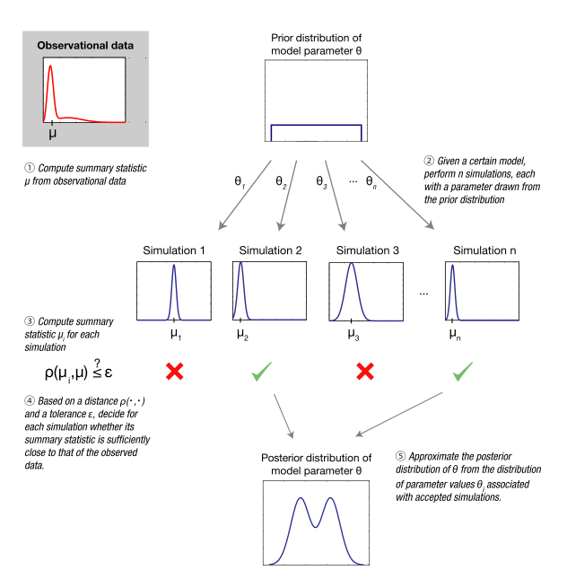
In pop gen, ABC predates ML in combining summary statistics
Simulate under a variety of parameter values
Summary statistic from real data set.
Which simulations “look like” our real data?
Estimate posterior probability distribution of model params from these “accepted simulations”
Sunnåker et al. (2013)

Slide 27
Strengths and limitations of ABC
Benefits of ABC:
flexibility: if you can simulate it and summarize it, then you can do inference (in principle)!
produces posterior density
Weaknesses:
you typically need a lot of simulations
for every prediction we have to examine entire training set
What about machine learning?

Slide 28
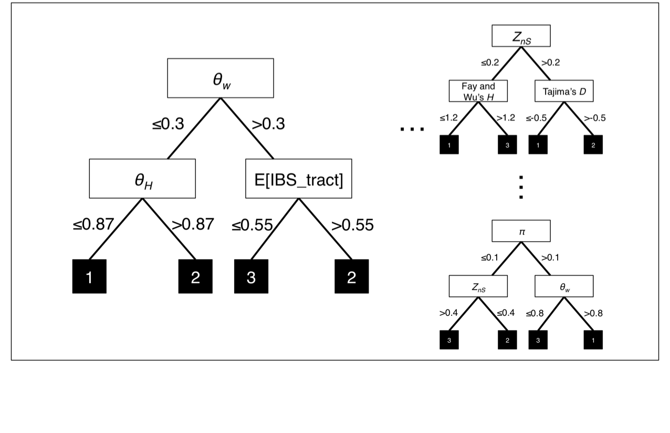
abcrf’s approach to demographic model selection
acbrf is just a Random Forest

Slide 29
abcrf beats ABC, and does it with fewer simulations
Method | Error with 10,000 training examples | Error with 20,000 training examples | Error with 50,000 training examples
ABC | 57.46% | 53.76% | 51.03%
abcrf | 40.18% | 38.94% | 37.63%
Pudlo et al. (2016)

Slide 30
Random Forest Regressor
Feature 2
Feature 1
≤0.78
>0.78
Feature 5
Feature 7
…
≤0.67
>0.67
≤0.4
>0.4
≤0.9
>0.9
16, 17
40, 50, 55
31, 57
3, 20, 27
Feature 2
Feature 3
…
≤0.87
>0.87
≤0.55
>0.55
Feature 2
≤0.1
>0.1
16, 17, 20, 27
3
31, 40
50, 55, 57
Feature 5
Feature 7
≤0.39
>0.39
≤0.85
>0.85
55, 57
50
3, 16, 17
20, 27, 31, 40

Slide 31
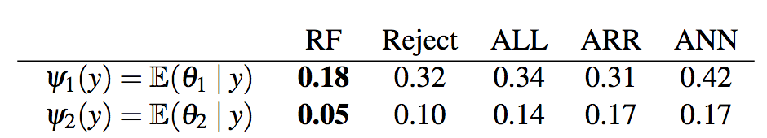
Parameter inference with abcrf
results on toy example, compared to various flavors of ABC:
Mean error for param 1:
Mean error for param 2:
Promising, but probably needs more testing…
Raynal et al. (2017)

Slide 32
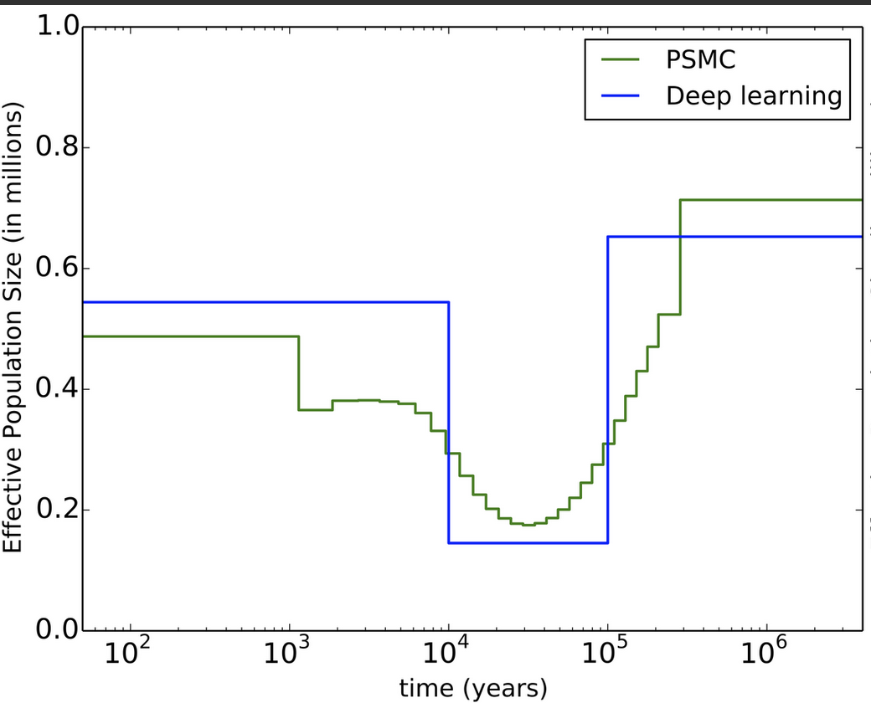
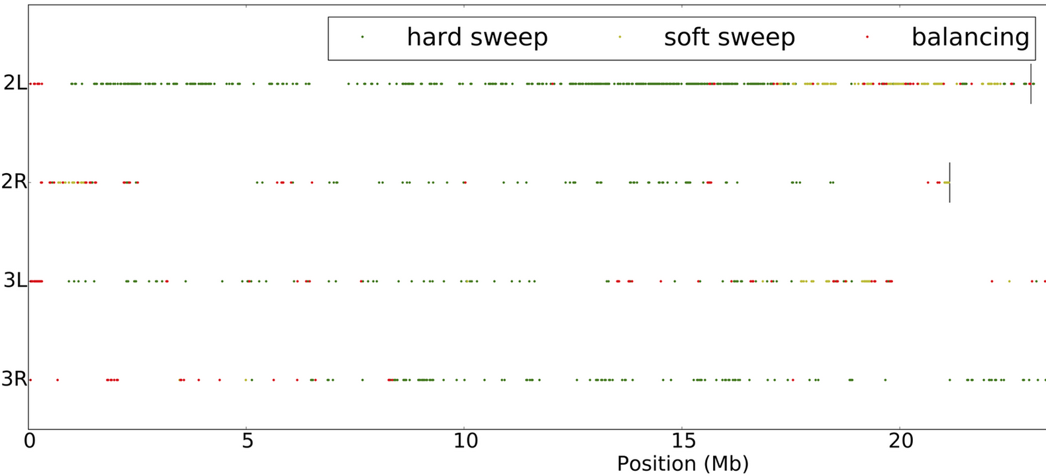
Co-estimation of demography and selective sweeps
These two phenomena both confound efforts to make inferences about the other.
Thus, co-estimation may be the most important outstanding problem in population genetics.
ML is one way to tackle it.
first real attempt: Sheehan and Song (2016)

Slide 33
Summary – demographic inference
Machine learning approaches are well suited for demographic inference (natural alternative to ABC)
Has only just begun to be exploited.

Slide 34
Part 3
Detecting sweeps with machine learning
Demographic inference
Recombination rate estimation
Detecting introgression
Population genetic inference with machine learning without summary statistics

Slide 35
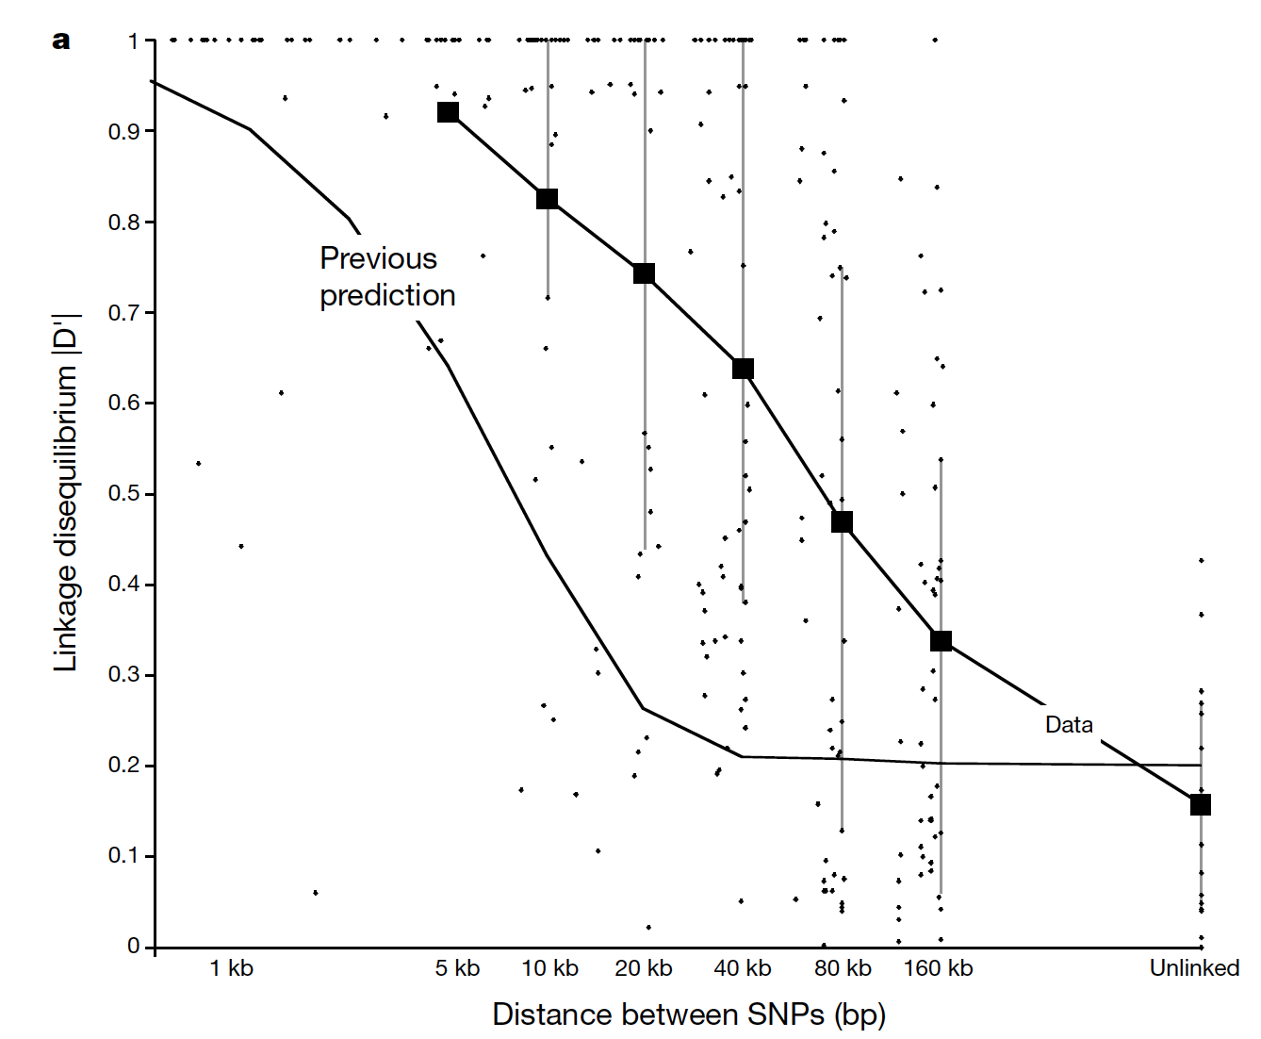
LD decays with distance
r
A
B
Δ_{r}x₁ = –rD
r increases with physical distance between the two sites

Slide 36
FastEPRR: estimate ρ=4Nr via boosting
We wish to calculate ρ in a window of fixed size.
First, in each window calculate each of the following:
Mean value of S_{k}² (Hudson 1987)
Mean r² for all pairs of SNPs in the window
Mean haplotype homozygosity
The number of distinct haplotypes
Simulate a training set, and train a regressor via boosting
Lin et al. (2013), Gao et al. (2016)

Slide 37
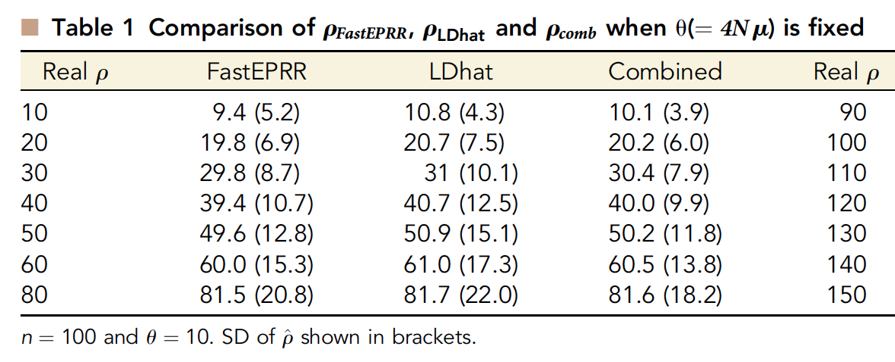
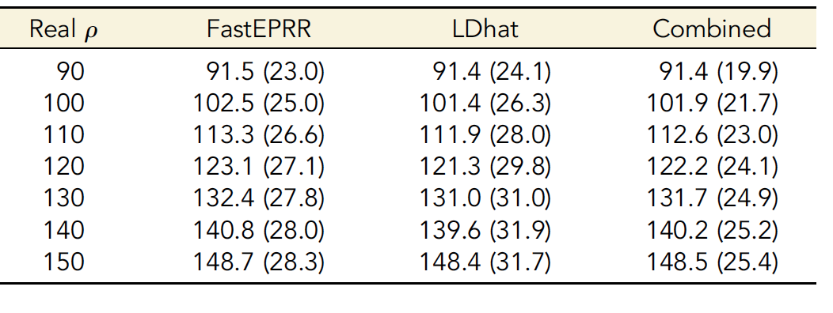
Similar accuracy to LDhat
Gao et al. (2016)

Slide 38
Advantages of FastEPPR
FastEPRR can naturally handle missing data
--Simply incorporate into your training simulations
FastEPRR can use much larger sample sizes:
--Full 1KG data set on single core:
~3d for FastEPR
years for LDhat
Larger sample size -> higher accuracy.

Slide 39
Summary (recomb rate)
FastEPRR is pretty impressive (accurate and fast)
But still only using a fairly low-dimensional summary of the data. We can probably do even better!

Slide 40
Part 4
Detecting sweeps with machine learning
Demographic inference
Recombination rate estimation
Detecting introgression
Population genetic inference with machine learning without summary statistics

Slide 41



Detecting introgression
vs.

Slide 42
Single Statistic vs. Feature Vector
d_{min}
[π₁, π₂, θ_{w1}, θ_{w2}, Z_{nS1}, Z_{nS2}, F_{ST}, d_{min}, G_{min}, d_{d1}, d_{d2}, Z_{X}, IBS …]

Slide 43

Finding Introgressed Loci using Extra-Trees
Snn
d_{min}
≤0.78
>0.78
…
Taj D₂
>0.6
Taj D₂
≤0.1
>0.1
≤0.6
≤-0.9
>-0.9
2
3
3
1
d_{d1}
d_{d1}
…
≤2.0
>2.0
≤1.0
>1.0
G_{min}
≤0.05
>0.05
1
2
3
2
E[IBS]
>100
E[IBS]
≤100
≤50
≤50
2
3
3
1
Schrider et al. (2018; PLoS Genetics)

Slide 44
Single statistics have little power
d_{min}
G_{min}
P_{M}
P_{M}
T_{M}
T_{M}
False positive rate: 5%

Slide 45
FILET has exceptional power
FILET
d_{min}
P_{M}
G_{min}
T_{M}
FP rate: 5%
False positive rate: 0.09%

Slide 46
Summary (introgression)
Clearly lots of potential here but few attempts at applying ML to this problem so far.

Slide 47
Part 5
Detecting sweeps with machine learning
Demographic inference
Recombination rate estimation
Detecting introgression
Population genetic inference with machine learning without summary statistics

Slide 48
Going in reverse
Infer presence of phenomenon of interest
Sweep or no?
Capture properties of genealogy with vector of statistics
e.g. iHS, nSL
Sequence alignment

Slide 49


Inference via Convolutional Neural Network (CNN)
Infer presence of phenomenon of interest
Capture properties of genealogy with vector of statistcs
Lex Flagel
Sequence alignment
Photo credit: techcrunch.com

Slide 50
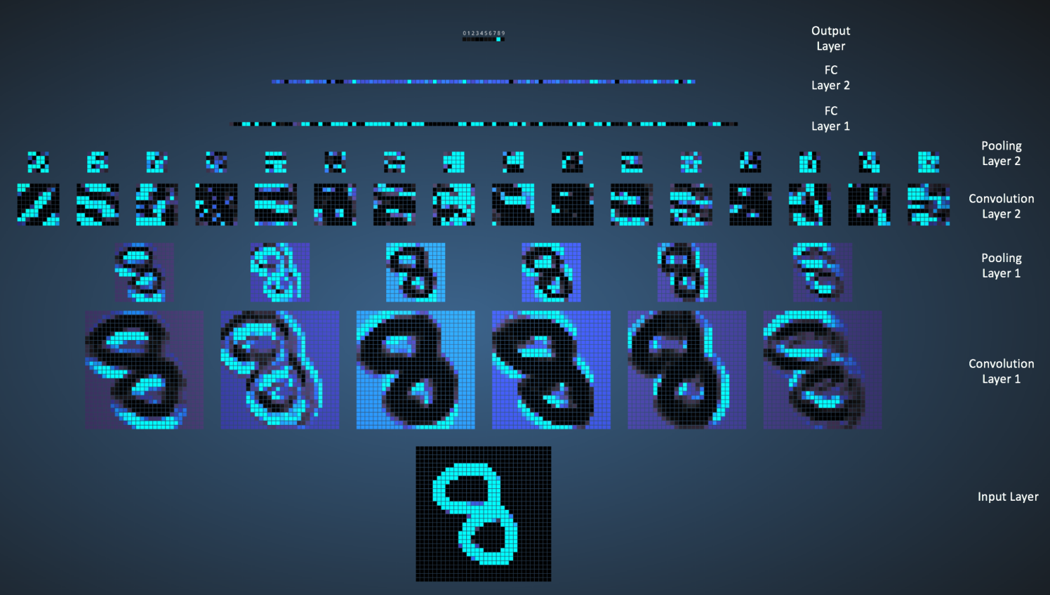
Convolutional Neural Network
image made by Ujjwal Karn using Adam Harley’s awesome interactive tool

Slide 51
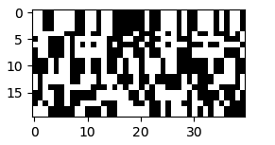
What if this is our input?
…
Samples
Genomic positions
What can we infer about a population sample’s evolutionary history using a CNN?

Slide 52
Finding Introgression via classification

Slide 53
CNN > FILET
Flagel et al. (2019; MBE)

Slide 54
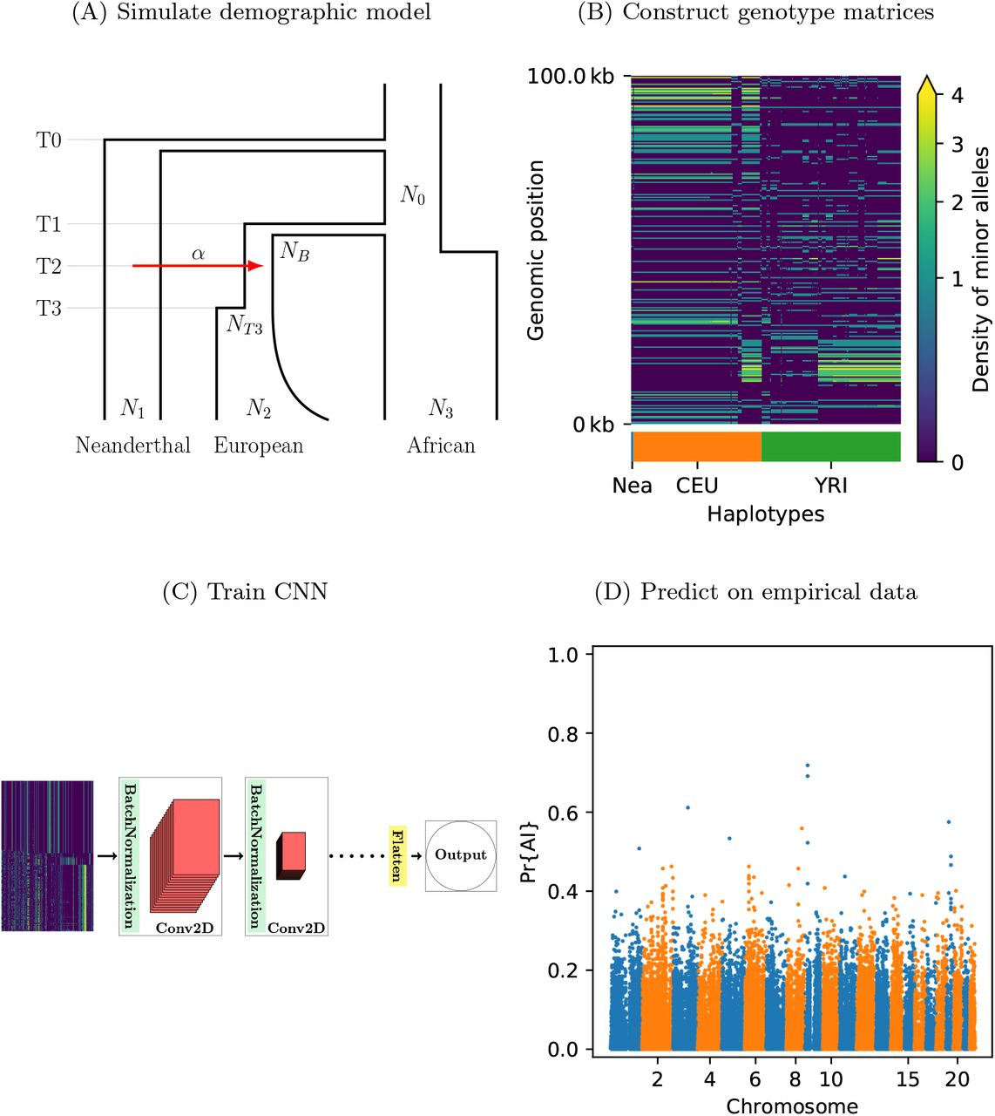
Adaptive introgression
Gower et al. 2020

Slide 55
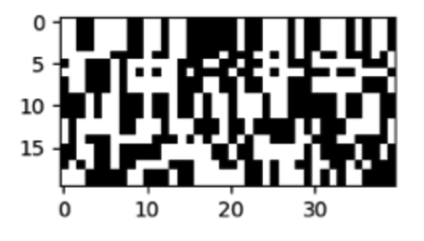

Detecting sweeps:
121 features vs. alignment image
CNN
S/HIC
…

Slide 56
Inferring recombination rates
Simulations for training (CNN) and testing (both):
20 kb loci (human-ish parameters)
variable N_{e}
variable recombination rate
LDHat
CNN
Predicted recomb rate
True recomb rate
RMSE: 0.0160
R²: 0.768
True recomb rate
RMSE: 0.0126
R²: 0.862
Flagel et al. 2019

Slide 57
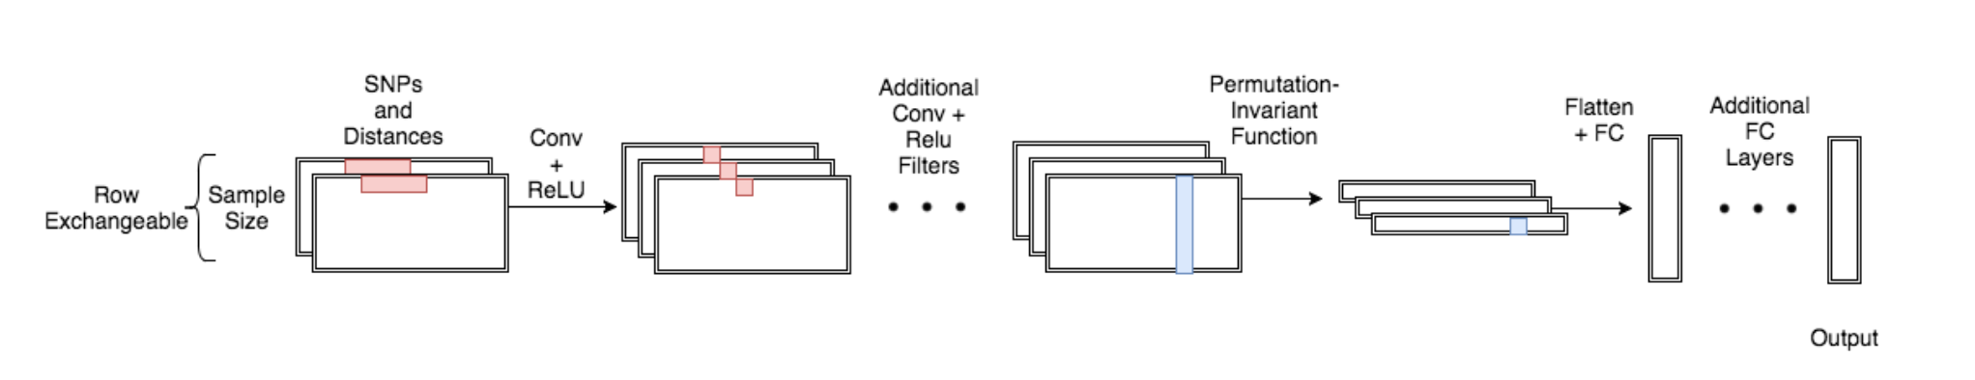
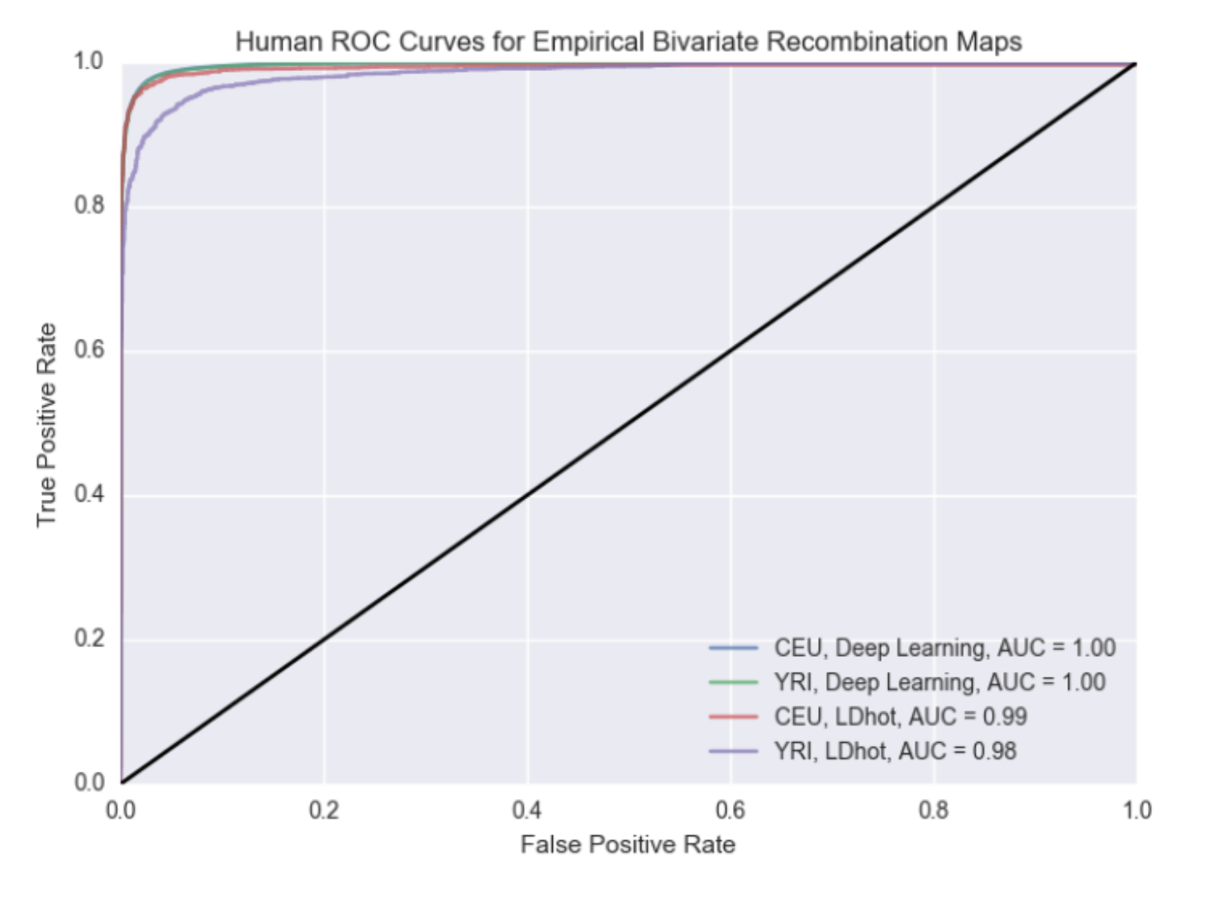
Finding recombination hotspots
Chan et al. 2018

Slide 58
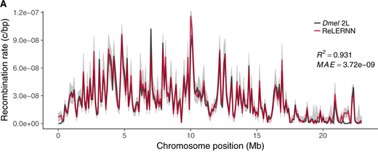
Estimating recombination rates with a GRU
Adrion et al. 2020

Slide 59
Inferring rec rate in tetraploids
RMSE: 0.012
R²: 0.83
Flagel et al. 2019

Slide 60
Inferring demographic parameters
N₀
Population size
N₂
N₁
T₂
T₁
Present
Time

Slide 61
Inferring demographic parameters
Flagel et al. 2019

Slide 62
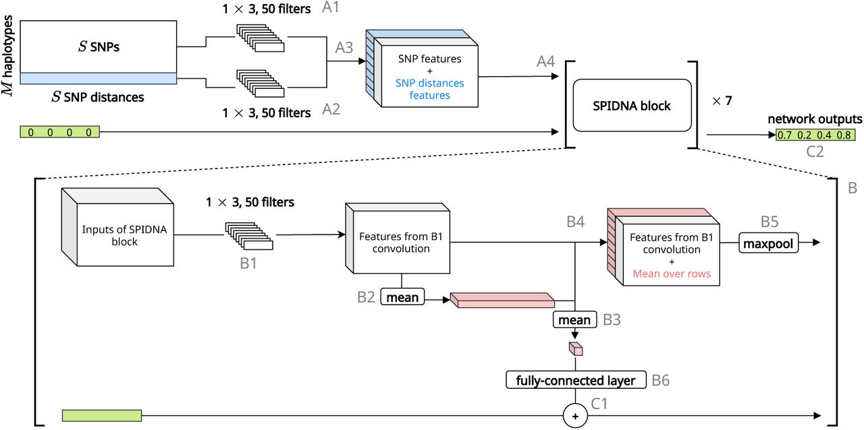
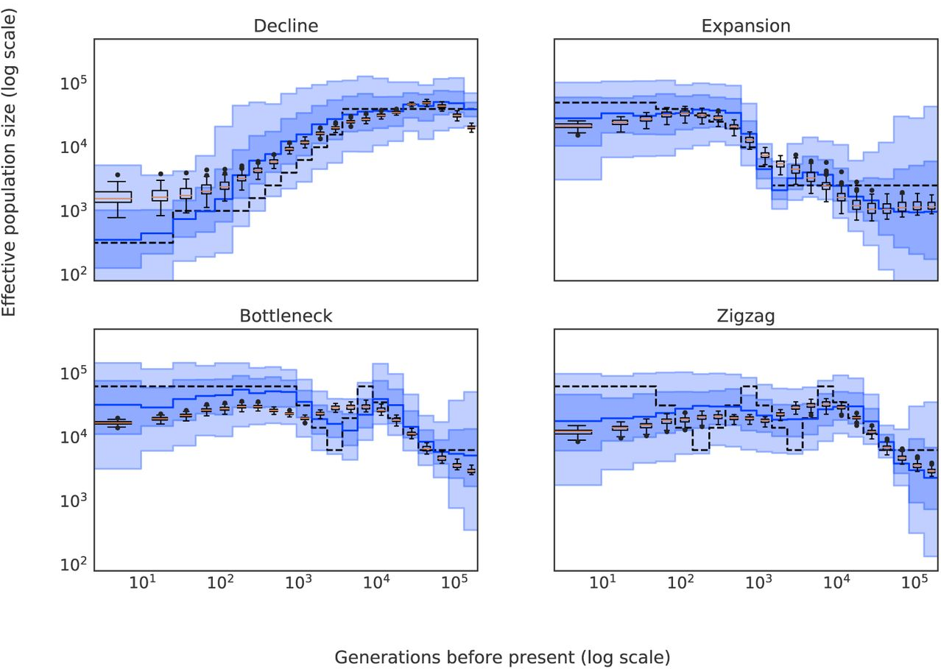
Population size trajectories
Sanchez et al. 2020

Slide 63
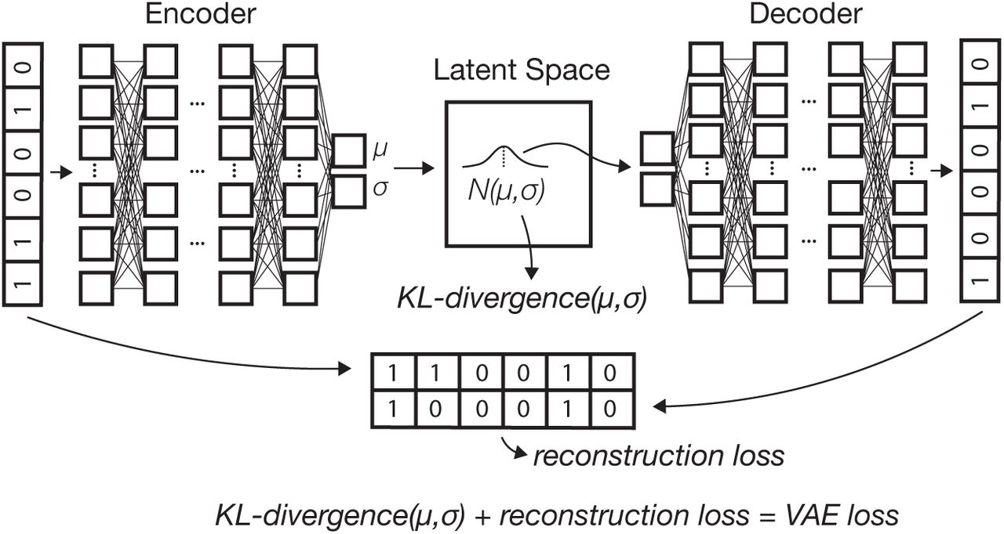
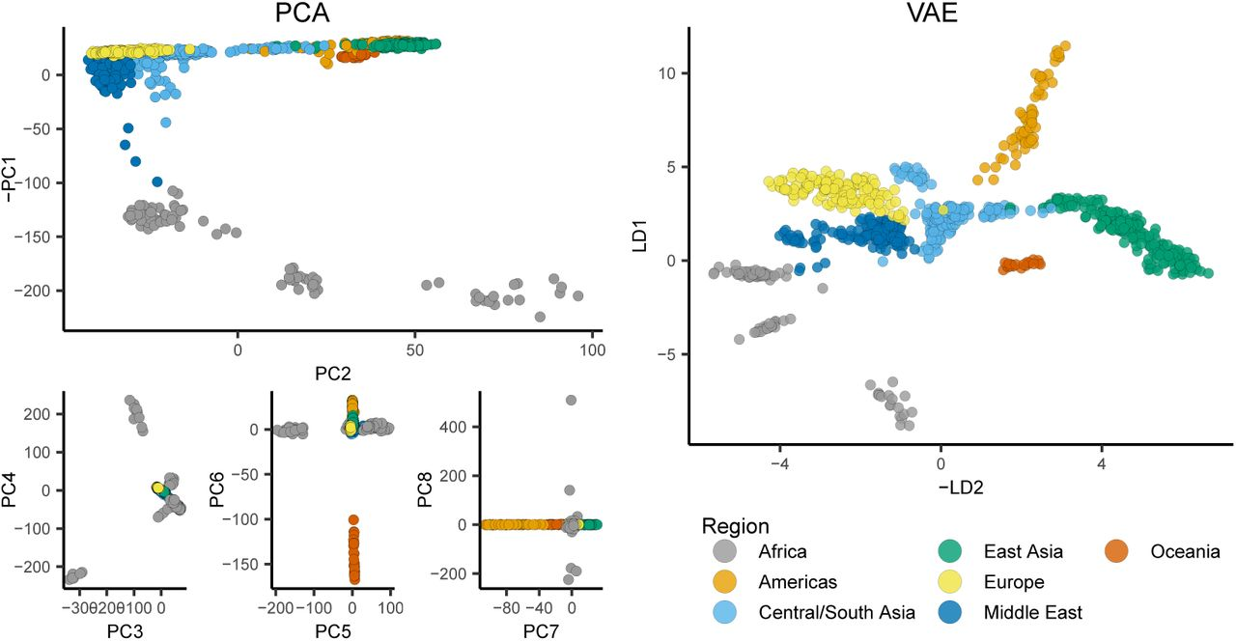
Visualizing population structure
Battey et al. 2020

Slide 64
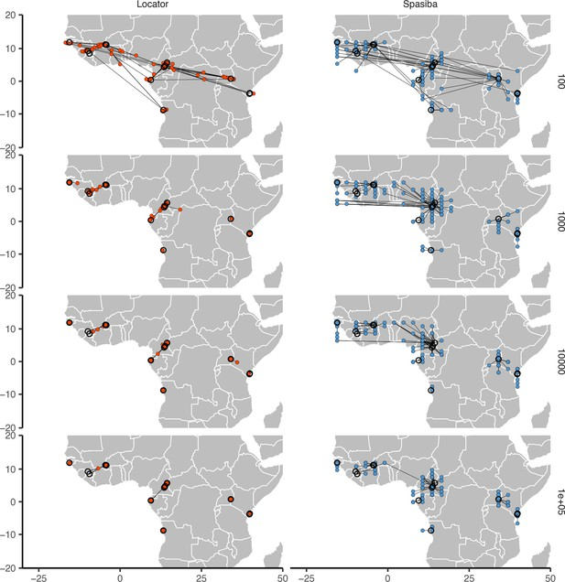
Predicting location from genotypes
Battey et al. 2020

Slide 65
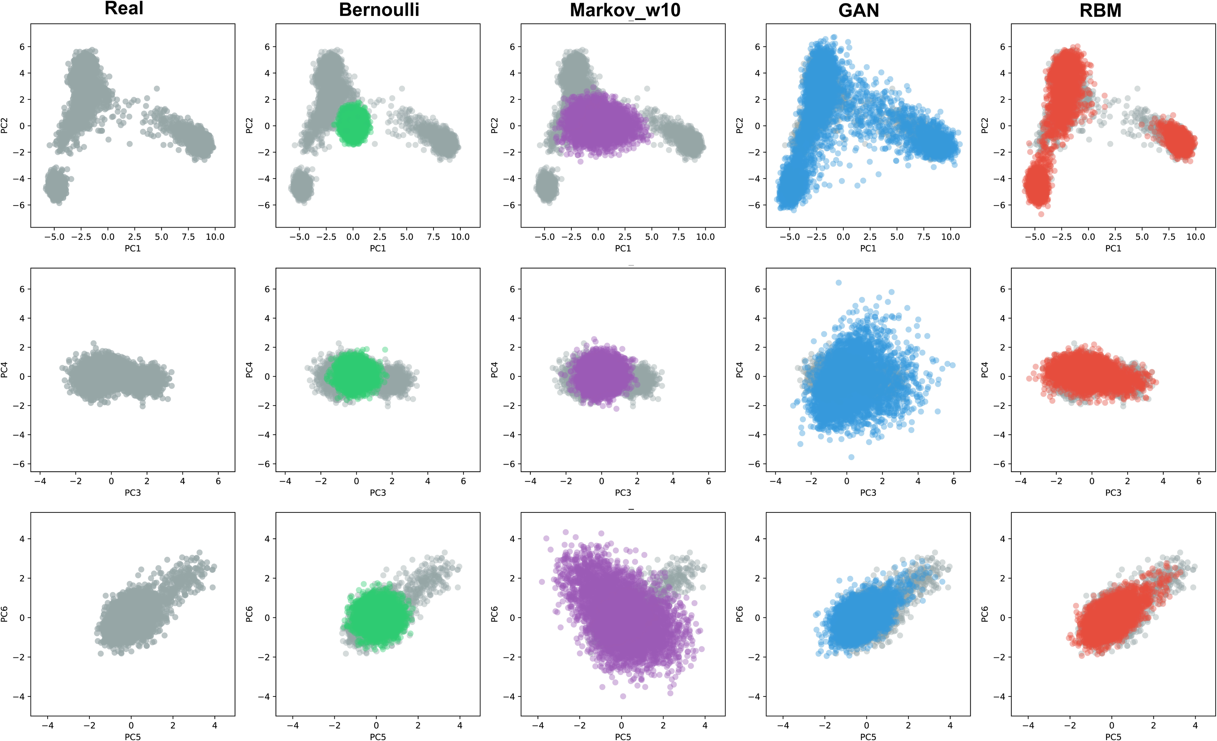
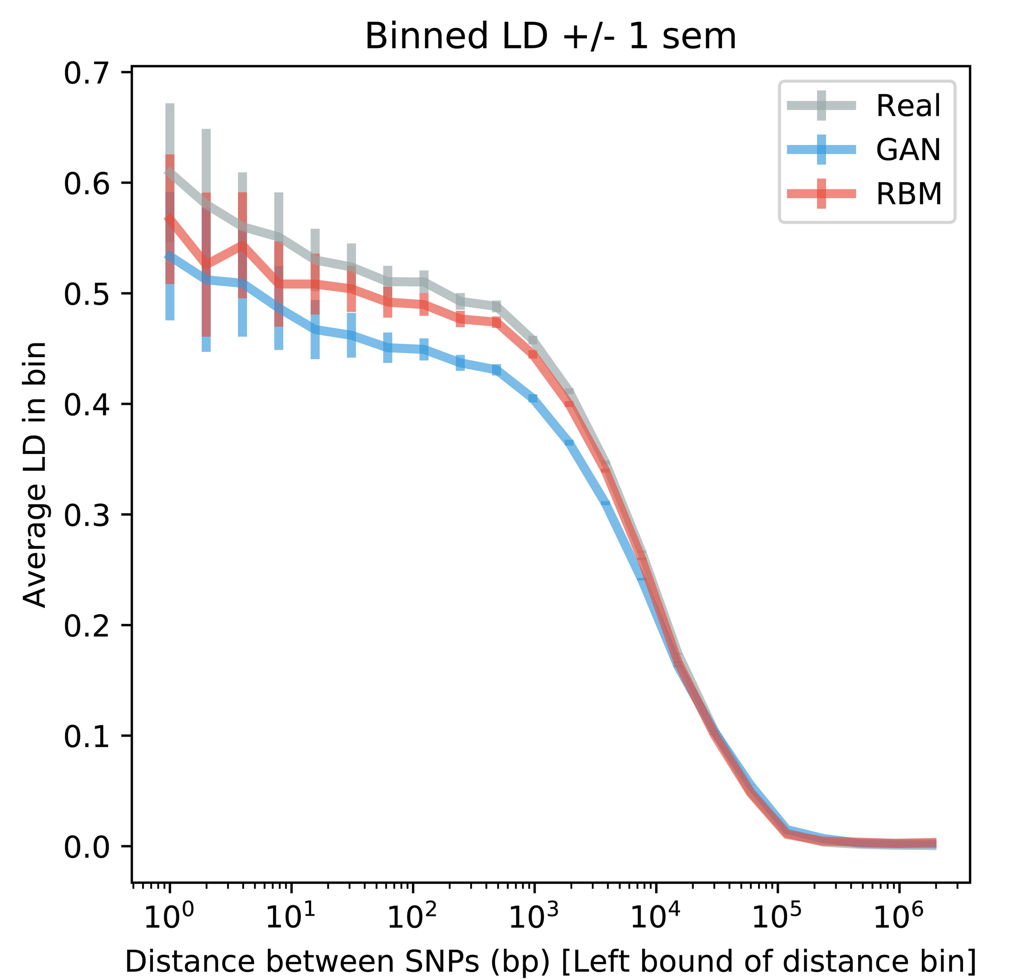
Generating artificial genomes
Yelman et al. 2020

Slide 66
Conclusions (part 5)
1) ANNs can extract from alignments salient information for making inferences about evolutionary phenomena.
2) This approach can outperform summary statistics (even large vectors thereof) designed by experts for this purpose.
3) Extremely flexible: can be applied to any problem for which we can obtain training data (no stats required).
4) Practical challenges remain. (Optimal representation, optimal network architecture, handling large/many alignments, etc). But things are moving FAST.

